Slide 1



Analysis of Historical IPL Data from
2021 to 2023
and Insights on IPL 2024
by SPORTS BASICS
Presented By
Peter Pandey
Sports Journalist

Slide 2

IPL
The Indian Premier League (IPL) is a professional Twenty20 cricket league in India,
contested during April and May of every year.
The league was founded by the Board of Control for Cricket in India (BCCI) in 2007
The IPL is the most-attended cricket league in the world
and ranks sixth among all sports leagues.
The current format of the IPL consists of a round-robin group stage followed by playoffs.
As of the latest season, the league features ten city-based franchise teams.

Slide 3
Objective: To analyze IPL data from 2021 to 2023, and provide predictive insights for the 2024 season.
This Report will focus on Four key sections
Batsmen Analysis
Bowler Analysis
Team Analysis
Predictions
1) Top 10 batsmen based on past 3 years total runs scored.
2) Top 10 batsmen based on past 3 years batting average.
3) Top 10 batsmen based on past 3 years strike rate
4) Top 5 batsmen based on past 3 years boundary % (fours and sixes).
1) Top 10 bowlers based on past 3 years Total wickets taken.
2) Top 10 bowlers with good bowling avaerage based on past 3 years
3) Top 10 bowlers with low economy rate based on past 3 years.
4) Top 5 bowlers based on past 3 years total dot balls
1) Top 4 teams based on past 3 years winning %.
2) Top 2 teams with the highest number of winning % achieved by chasing targets over the past 3 years
1) Orange and purple cap player
2) Top 4 qualifying teams
3) Winner and runner-up
4) Selection of Team with Best 11 players based on their positions, 3 years performance data and additional research
5) Top 3 all-rounder

Slide 4
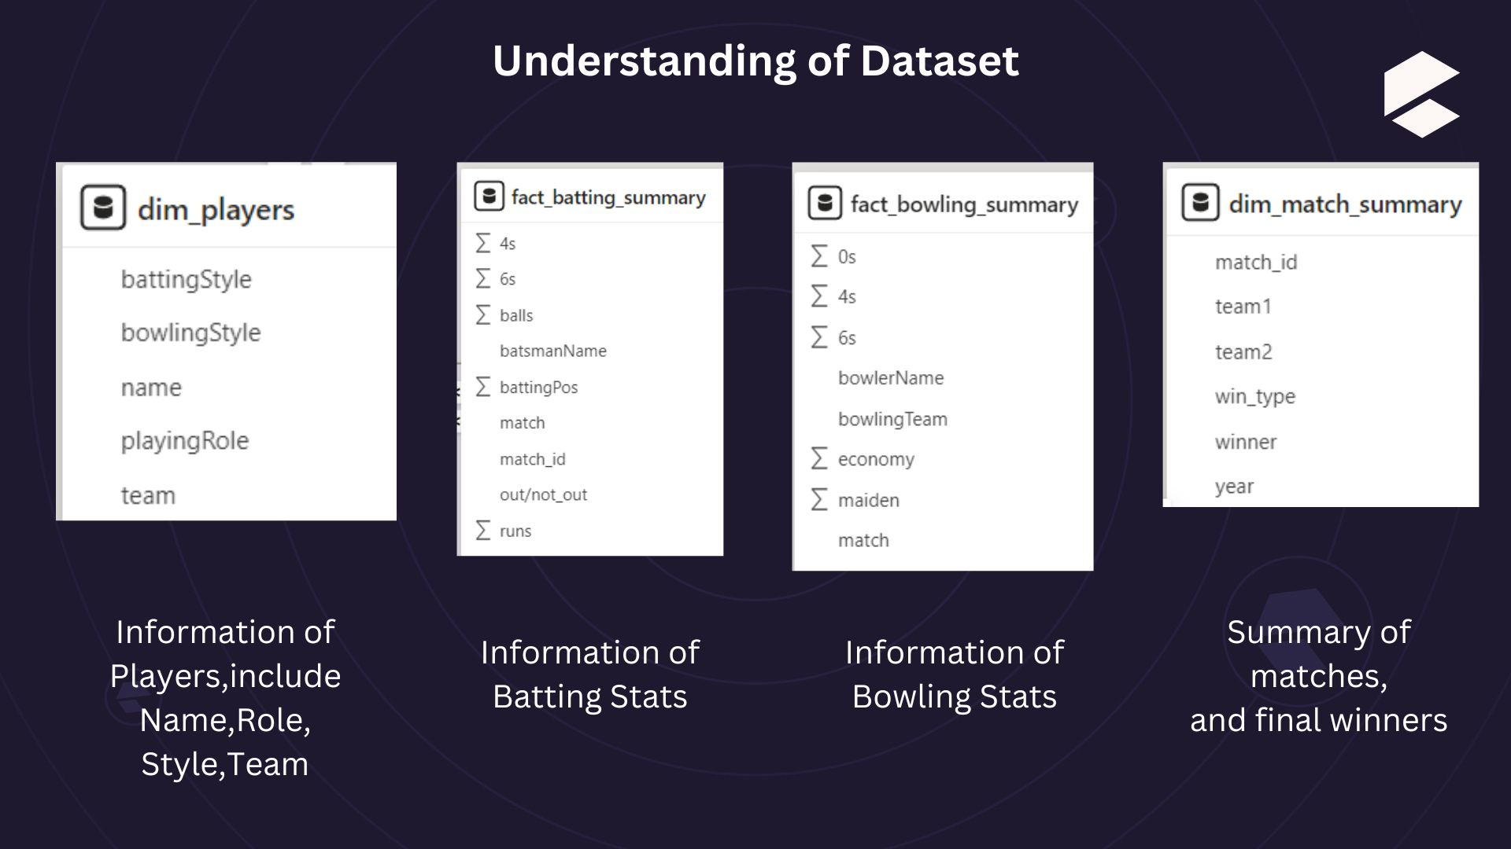

Slide 5
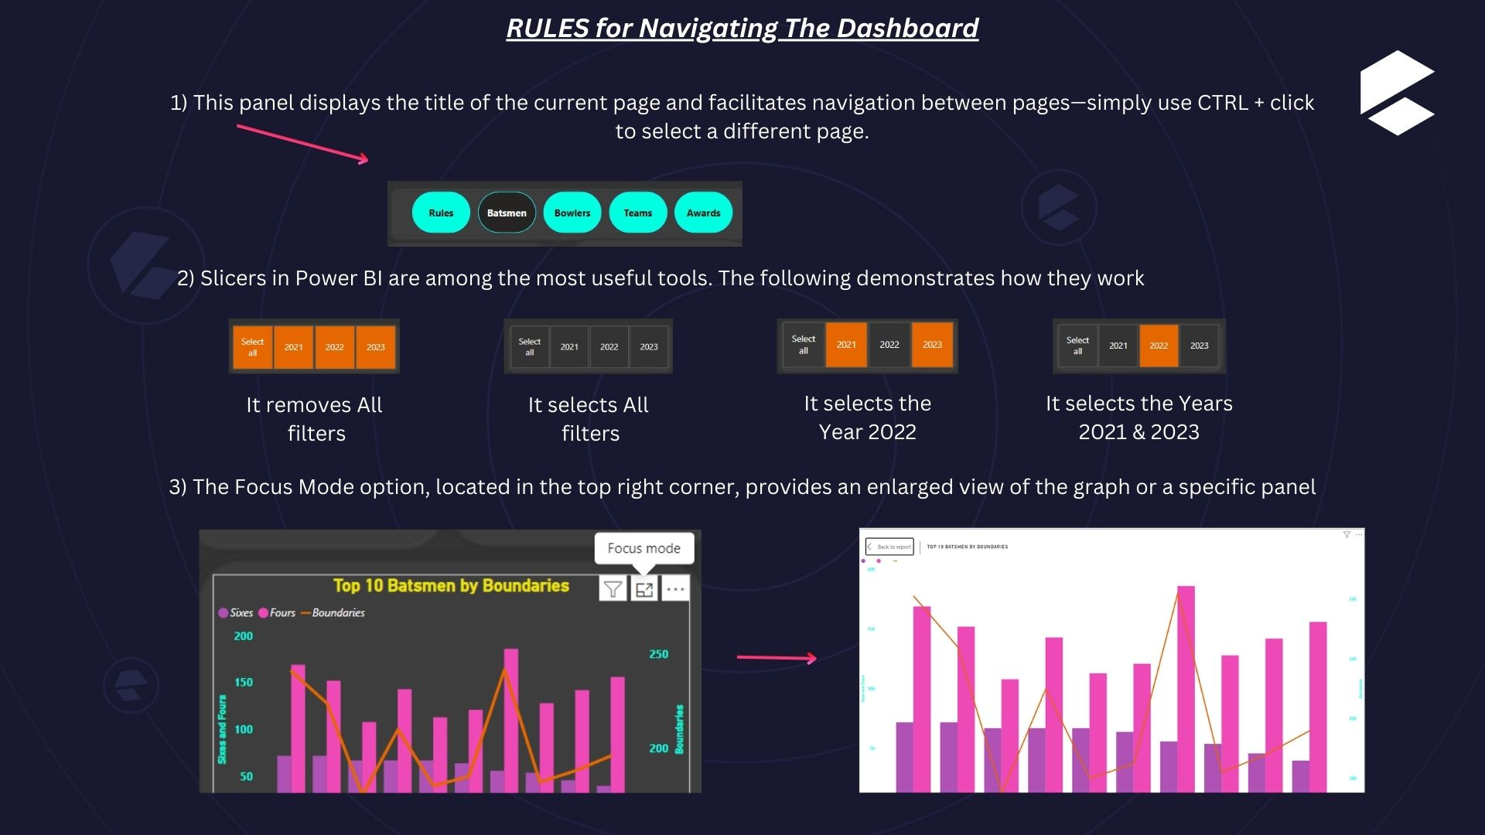

Slide 6
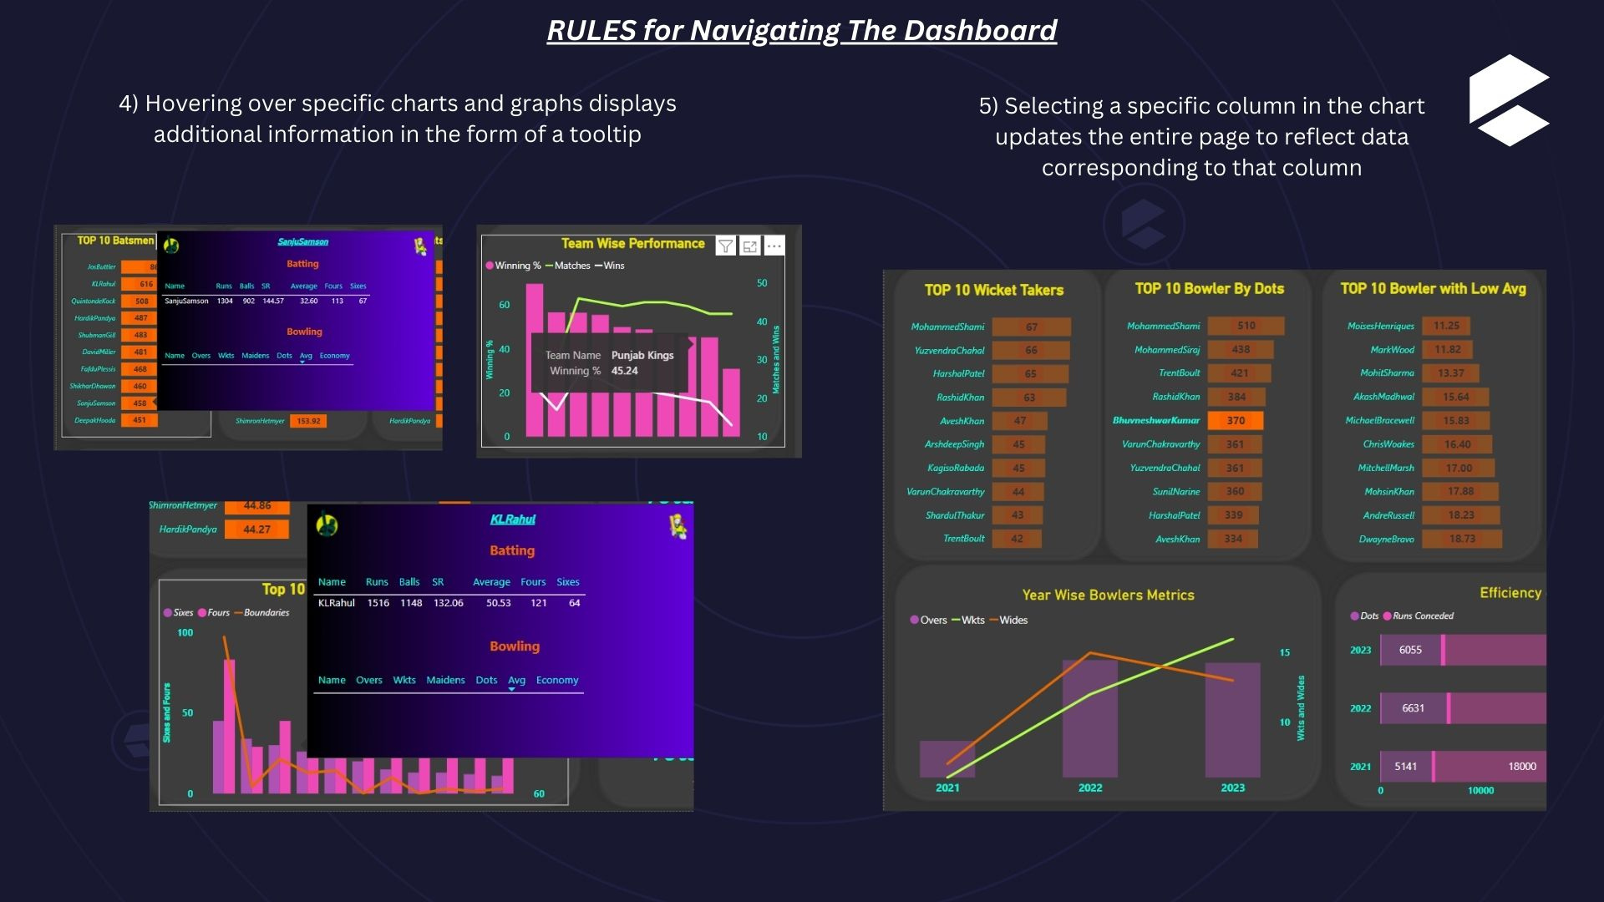

Slide 7
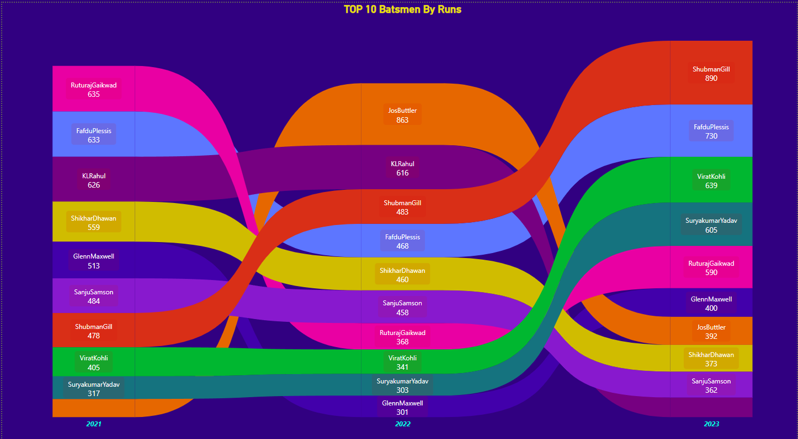
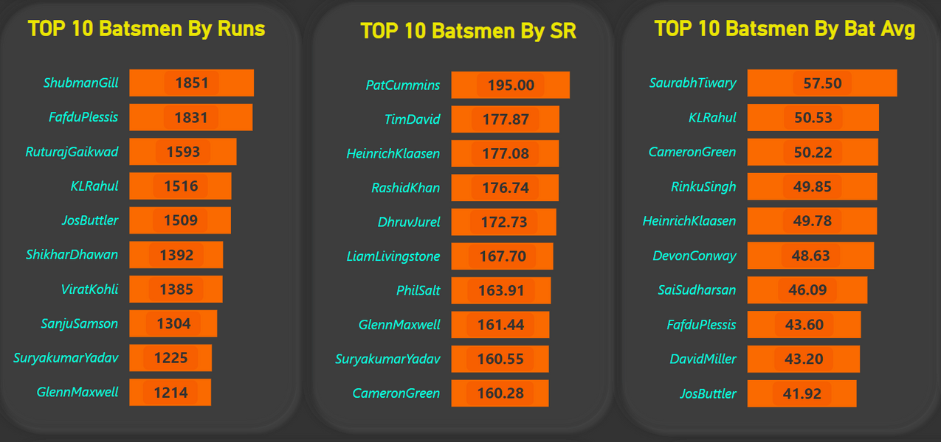
Top 10 Run Scorers
Kohli,Gill and SuryaKumarYadav have consistently performed well and have shown improvement year after year for the past three years.
Gill and Gaikwad are on top 3 among the top run scorers, and both have won Orange Caps.
KL Rahul is a wicketkeeper-batsman who is among the top 5
So, I am considering them for my dream team as Batsmen..

Slide 8
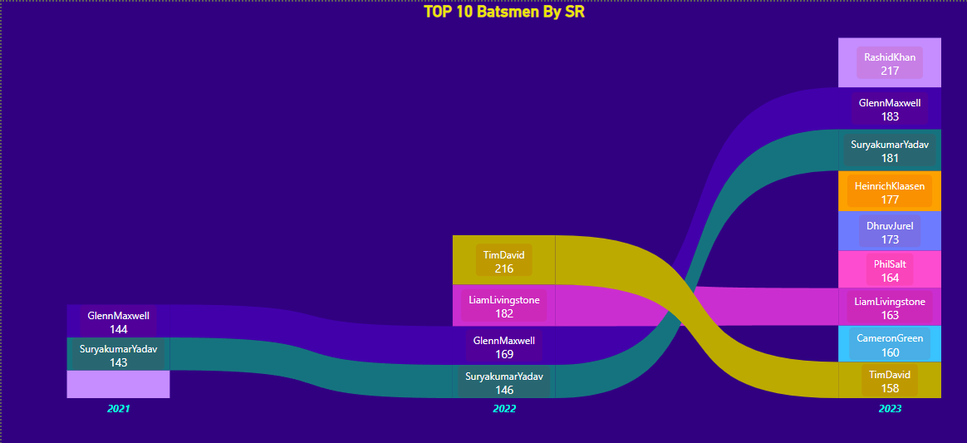
Top 10 Batsmen by Strike Rate & Batting Average
Suryakumar Yadav has a high strike rate and has shown consistent improvement over the past three years.
Heinrich Klaasen also has a good strike rate along with a superior batting average.
KL Rahul, as a wicketkeeper-batsman, maintains a commendable batting average.
So,considering them for my dream team as Batsmen..

Slide 9
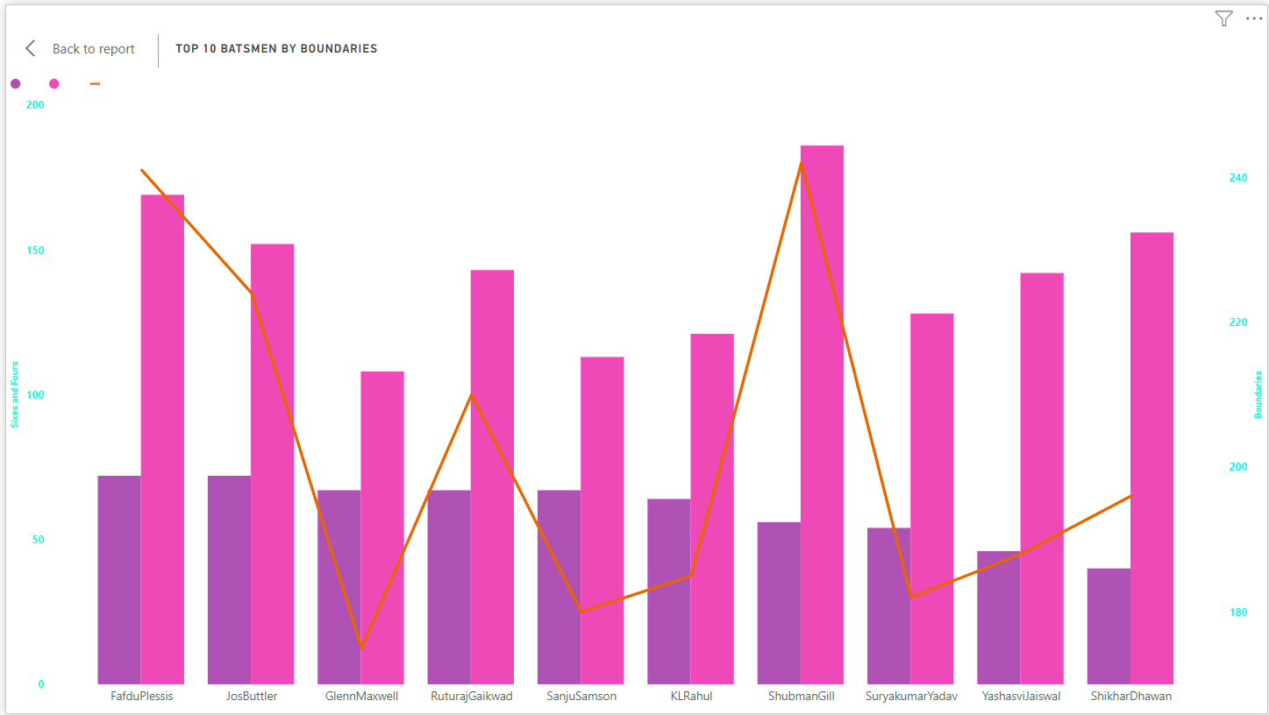
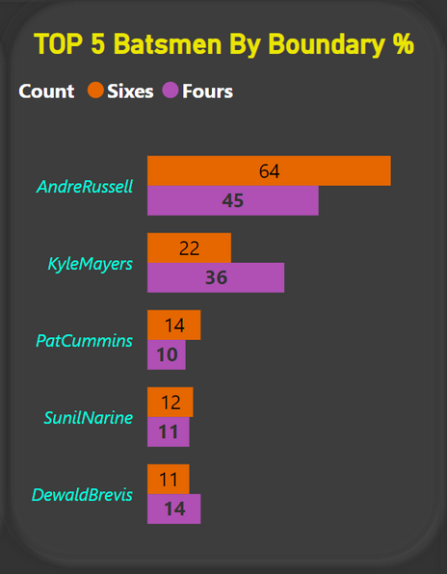
Top 10 Batsmen with Most Boundaries
Shubman Gill has hit a higher number of boundaries overall, also he has scored more fours.
Both Faf du Plessis and Jos Buttler have cleared the ropes with an equal number of sixes, tallying 72 each.
Additionally, Andre Russell has demonstrated a higher boundary percentage relative to the number of balls faced.

Slide 10
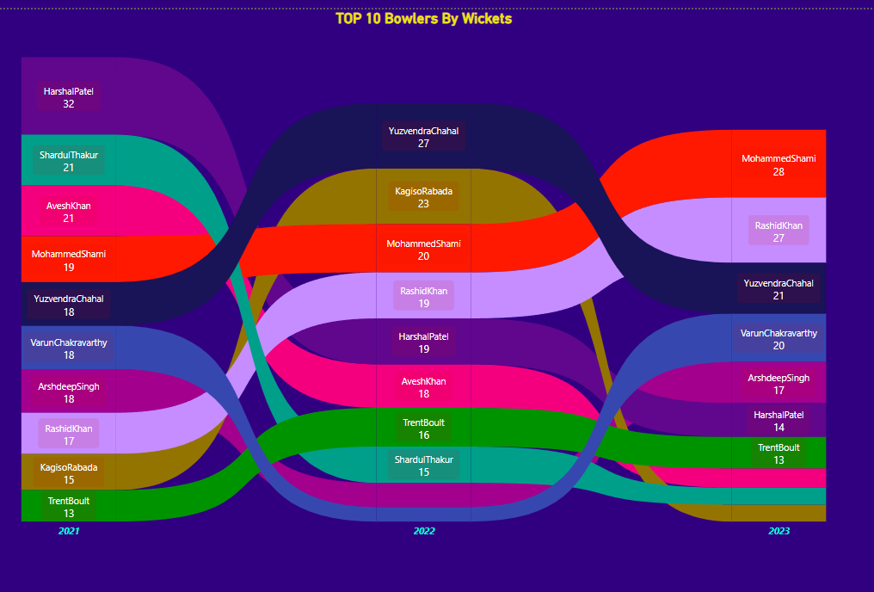
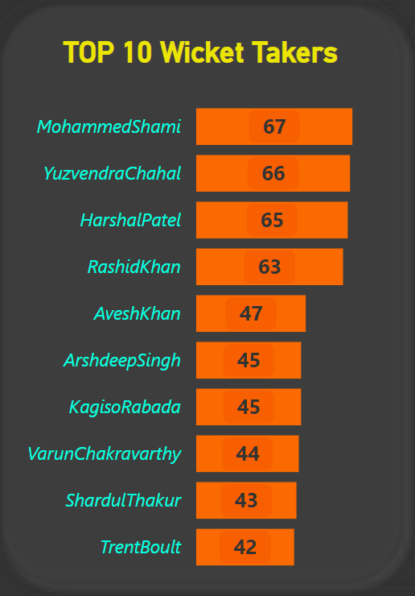
Top 10 Bowlers with Most Wickets
Both Shami and Rashid Khan have consistently performed well and have shown improvement year after year for the past three years.
Shami and Chahal are on top among the top wicket-takers, and both have won Purple Caps.
So, I am considering them for my dream team as bowlers..

Slide 11
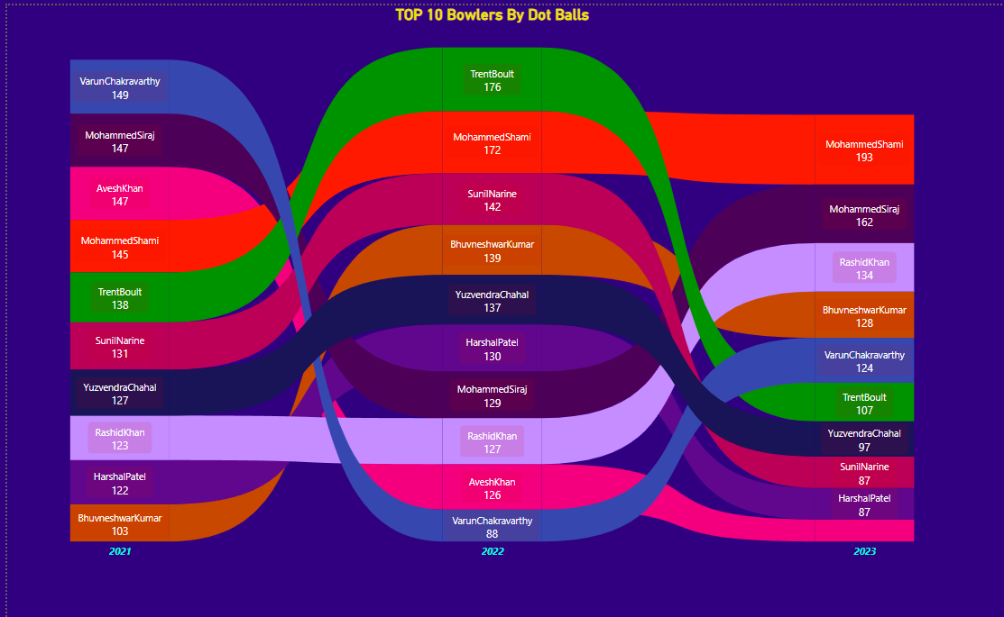
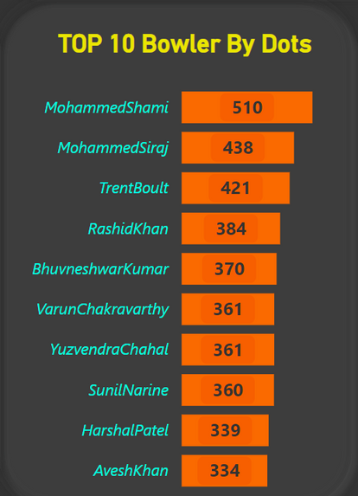
Top 10 Bowlers with Most Dot Balls
Both Shami and Rashid Khan have consistently performed well and have shown improvement year after year for the past three years. Moreover, they are skilled at taking wickets.
So, I am considering them for my dream team as bowlers..

Slide 12
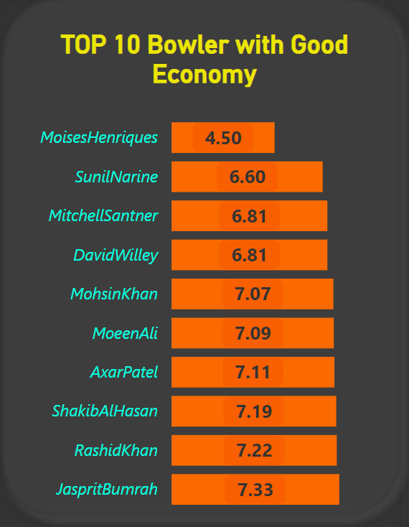
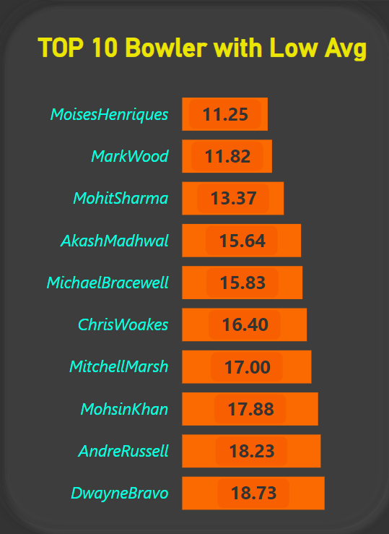
Top 10 Bowlers with Better Bowling Average and Low Economy Rate
Moises Henriques has a commendable bowling average and a low economy rate.
The data indicates that , all-rounders have maintained a better economy rate than specialist bowlers.

Slide 13
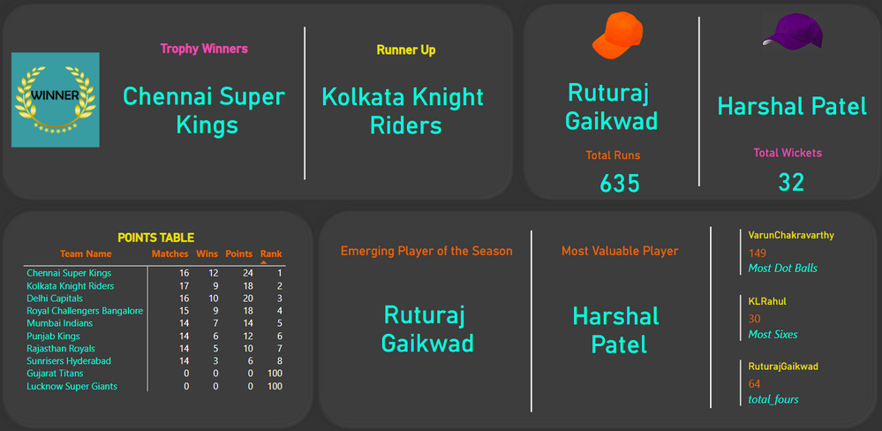
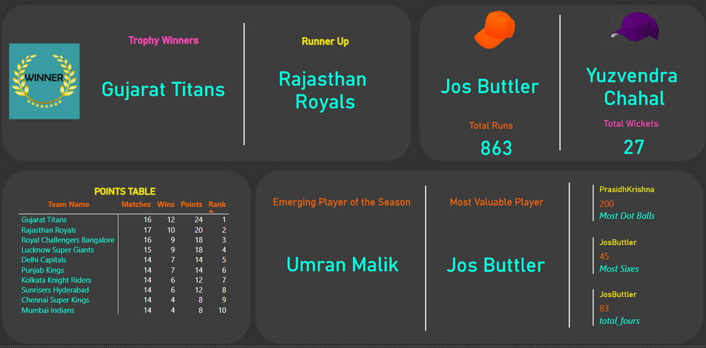
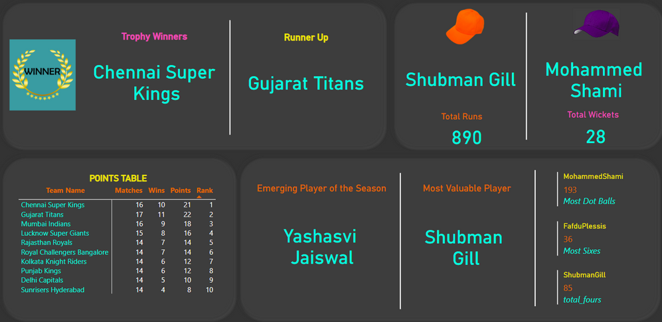

The Awards for IPL (2021-2023)
The Chennai Super Kings have won the IPL title twice.
The Gujarat Titans have reached the finals twice.
Both Royal Challengers Bangalore and Lucknow Super Giants have made it to the playoffs twice.
The Sunrisers Hyderabad have been at the bottom of the points table twice.

Slide 14
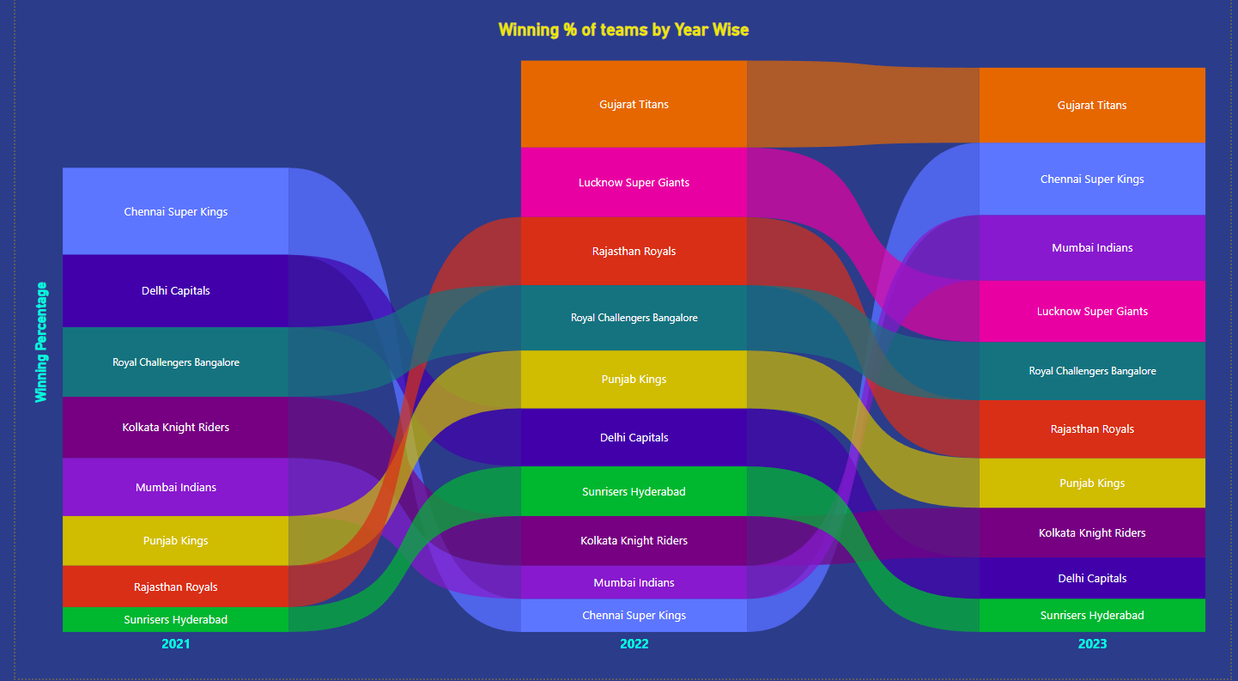
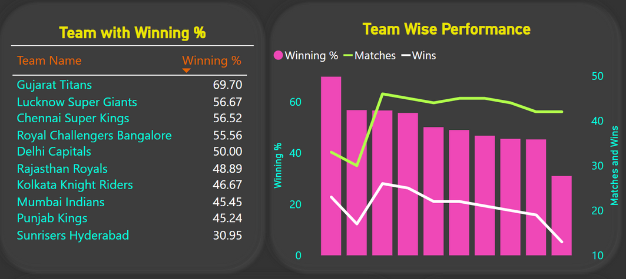
Team wise Winning Percentage
The Chennai Super Kings, Lucknow Super Giants, and Gujarat Titans have a higher winning percentage in the matches they’ve played, which suggests they have better chances of advancing to the playoffs.

Slide 15
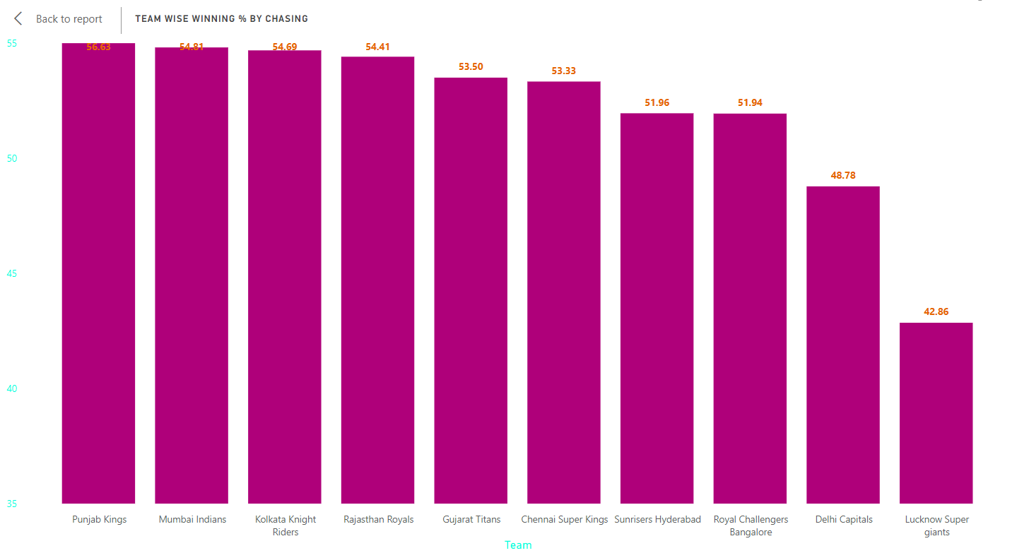
Teams Winning Percentage by Chasing
The teams Punjab Kings, Mumbai Indians, Kolkata Knight Riders, and Rajasthan Royals have a higher winning percentage when chasing targets.

Slide 16
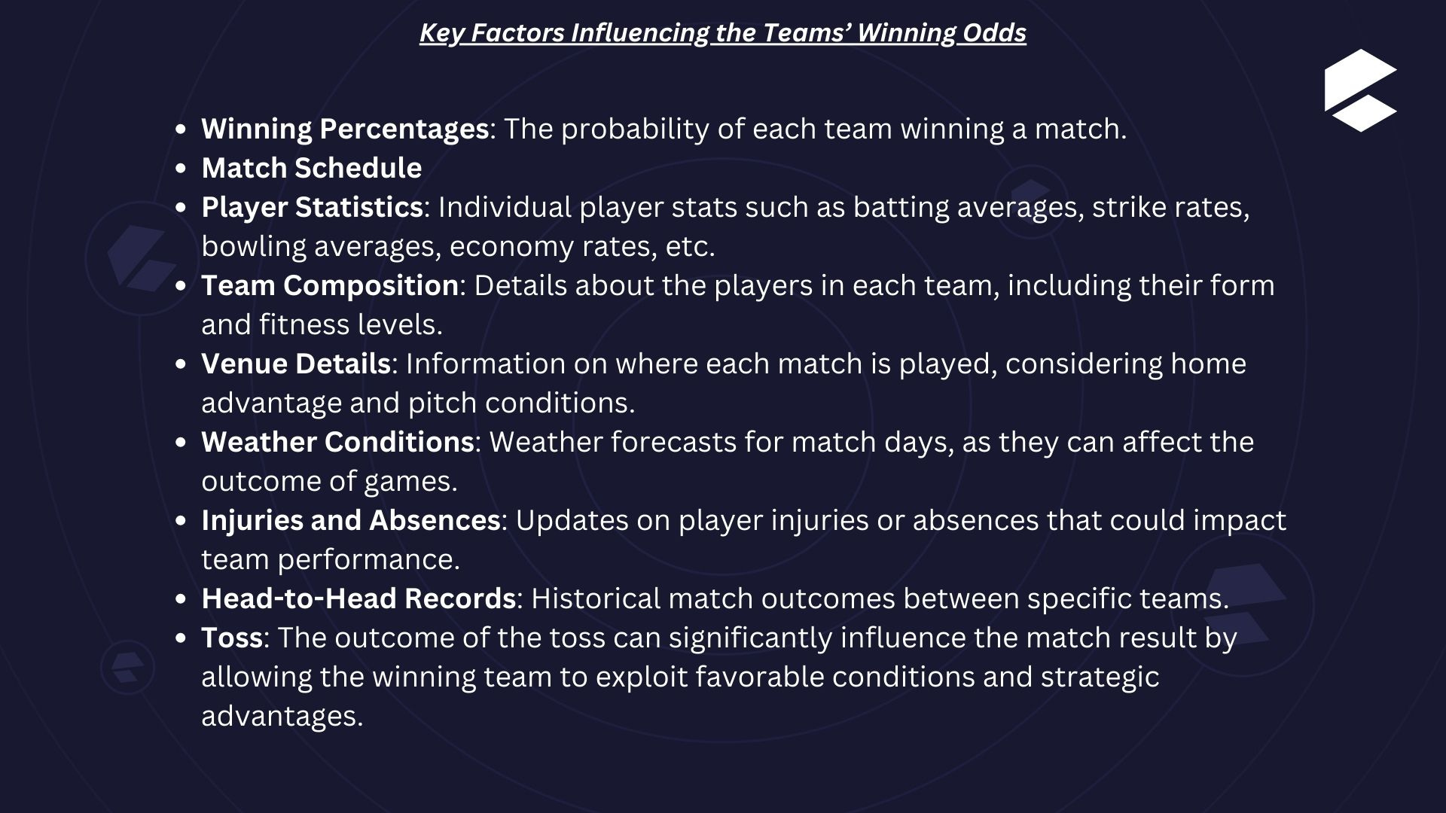

Slide 17
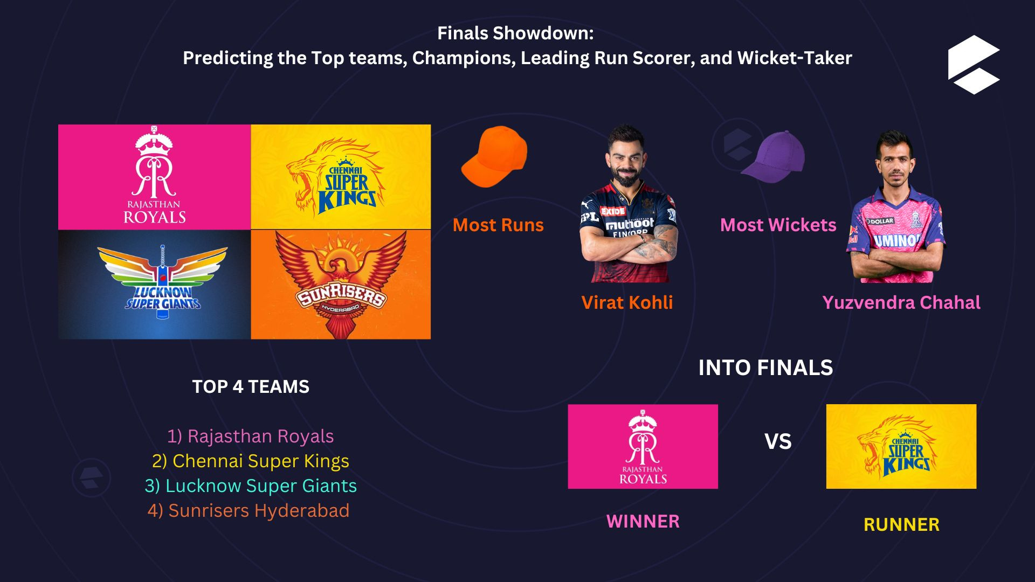

Slide 18
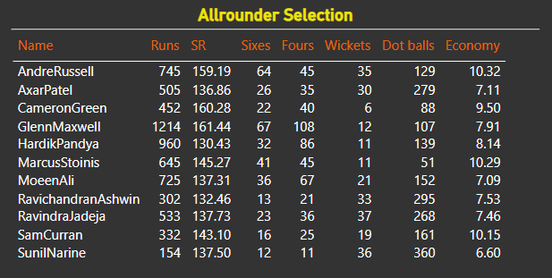
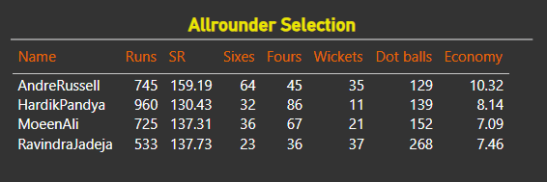
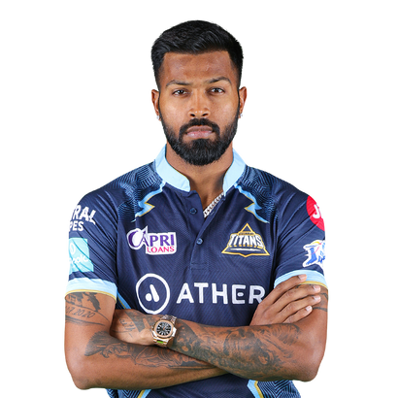
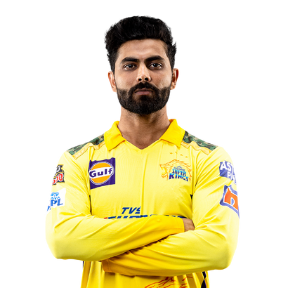
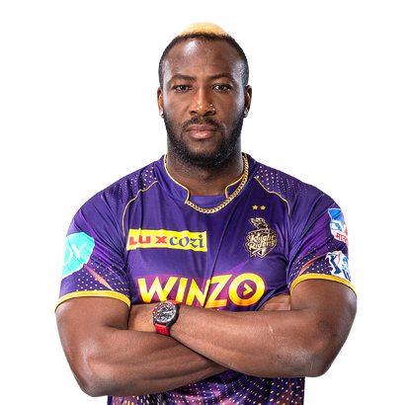

Selection of Top All-Rounders
I have chosen 11 all-rounders, from various sources based on their performance statistics.
Based on below criteria I shortlisted 4 of them.
Scored more than 520 runs
Had a strike rate over 130
Hit more than 20 sixes
Hit more than 30 fours
Bowled more than 120 dot balls
The final picks include a specialist batting all-rounder, a key bowling all-rounder, and one exceptionally balanced all-rounder
Hardik Pandya
Ravindra Jadeja
Andre Russell

Slide 19

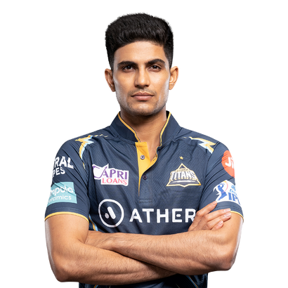
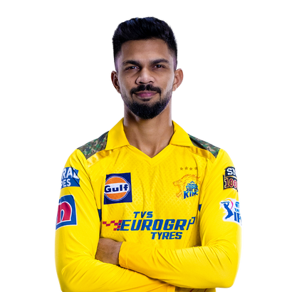
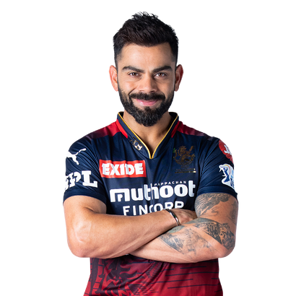
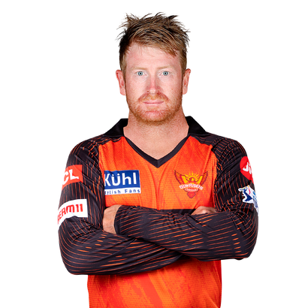


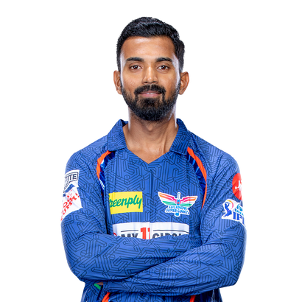



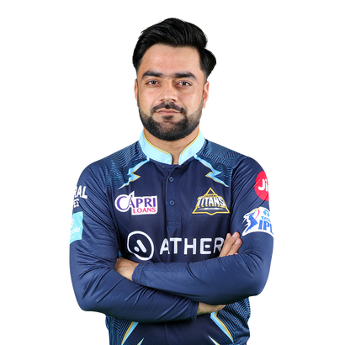
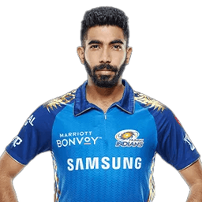
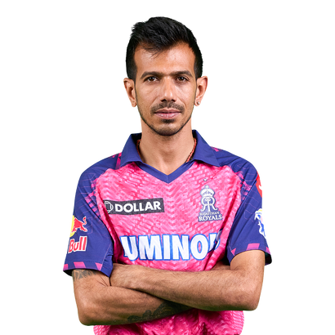
For IPL Fans, here’s my pick for the Playing XI in the Dream Team
Shubman Gill
Ruturaj Gaikwad
Virat Kohli
Heinrich Klaasen
KL Rahul (C)
Ravindra Jadeja
Hardik Pandya
Andre Russell
Rashid Khan
Jasprit Bumrah
Yuzvendra Chahal

Slide 20




THANKS
Presented By
Thank you for your attention.
I hope you found the presentation informative and insightful.
I’m now open to any questions or feedback you may have.
Please feel free to share your thoughts or inquire about any aspects you wish to discuss further.

